Slide 1
Welcome to Mr. MacLennan’s English Language Arts Classroom

Slide 2
Today Is… Monday, August 17th (8/17/20) |  | Reminders: Check your email every day!
Agenda: Introductions Class Expectations Personal Questions Assignment |  | Due Dates: Due Today
 | Objective: Today you will tell me a little about you and you will learn a little about me and our class.
Period 1 - Eng. 9 H
Period 2 - Eng. 11 CP
Period 3 - Eng. 11 CP
Period 4 - Eng 9H
Period 6 - Baseball
Notes:
Notes about this Template: You can change all text and the image. Add links or text to the appropriate sections as needed. Each day (or as appropriate for the schedule), just duplicate a blank slide (or your previous slide) to get a new slide, leaving the most recent at the top. Add your Bitmoji (use the extension and search “pose” for it without objects or text) or another avatar or picture of you and any other objects (desks, bookshelves, posters, whiteboards, furniture, etc.) or text boxes you would like. If you would like to add royalty-free images, use a site like https://unsplash.com/ to search for images that can be used and published. To remove backgrounds, use https://www.remove.bg/.
Based on a template from Dr. Katie Loftin and the trendy Bitmoji classrooms going around.

Slide 3
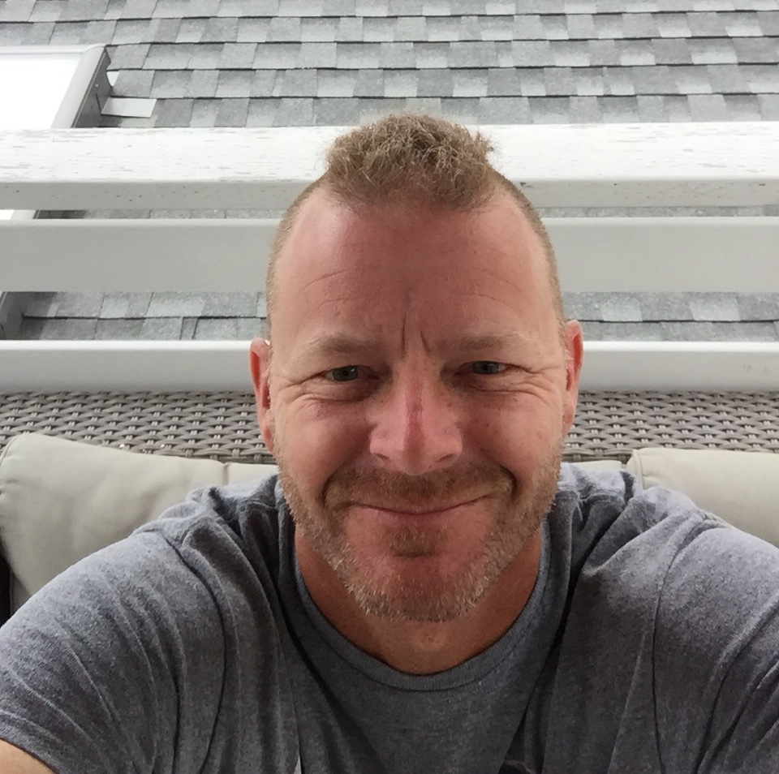
Who is Mr. MacLennan?

Slide 4
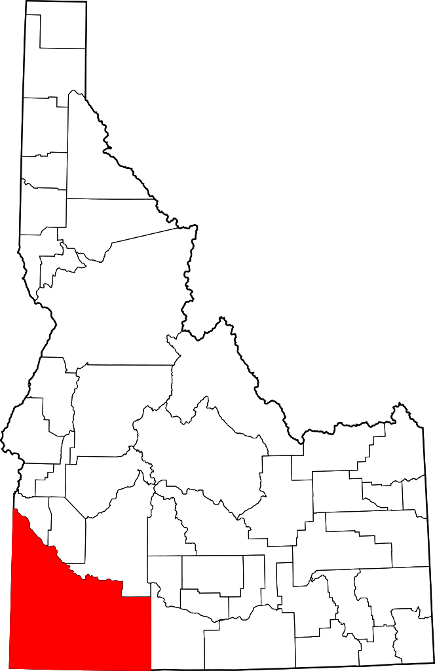
My background:
I was born and raised in Caldwell, Idaho.
I studied Literature at Vanguard University for my undergraduate degree.
After graduating, I got my teaching credential at Vanguard and began teaching right away.

Slide 5
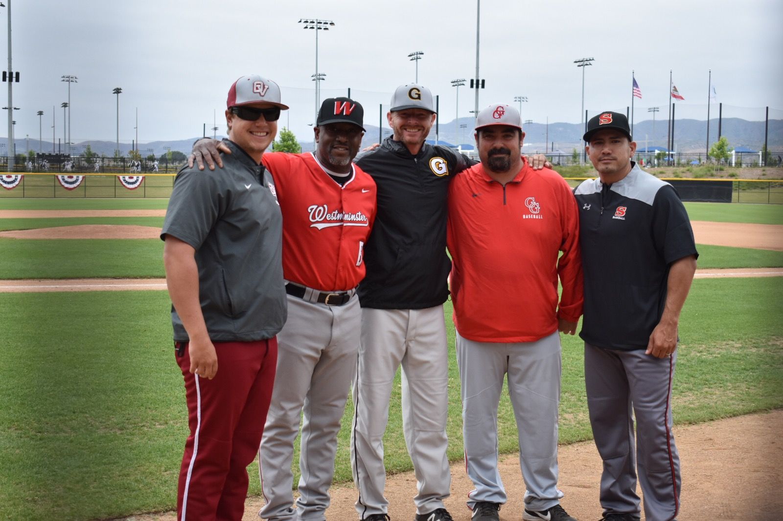
My background:
My first English teaching position was at Valley H.S. where I coached VB, BB, and eventually became the head Baseball Coach.
I earned my Master’s Degree in Education from New Mexico Highlands.
And I have been teaching English and coaching Varsity baseball at Godinez since it opened.
Now I teach adult classes and high school English at Godinez Fundamental High School. I live in Costa Mesa with my partner, Rachel.

Slide 6
Overview: What is the point of this class, anyway?

Slide 7
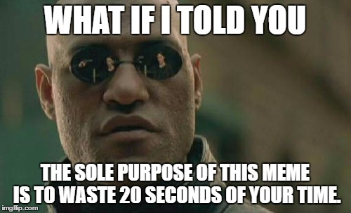
The purpose:
In other words…
Yes, we will read a lot.
We will write a lot.
We will try to answer the questions you have about the world around you and what it means for you.
The purpose of this course is to help you develop your literacy skills (reading, writing, speaking, and listening) while helping you understand the world around you and your place in it.

Slide 8
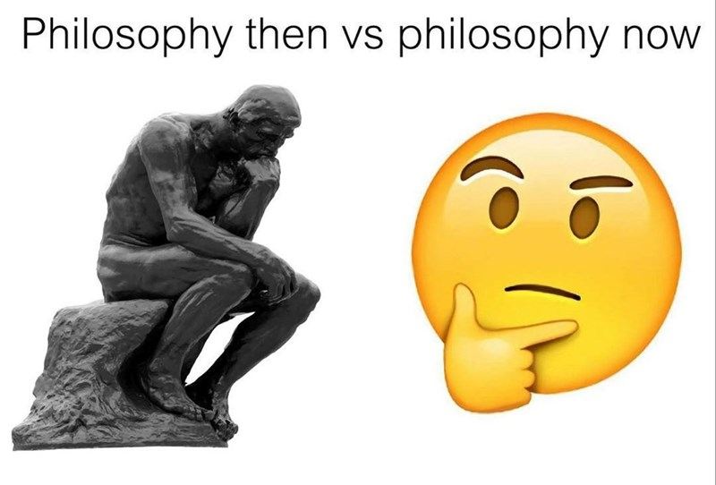
The philosophy:
In other words…
I believe that you have learned a lot from your own experiences. I want you to use that knowledge to explore reading and writing.
I will give you opportunities to explore your passions, interests, and curiosities this year.
As an educator, I am committed to the community cultural wealth model of teaching in which students are provided with a physical and intellectual space to recognize and leverage their personal skills and funds of knowledge.

Slide 9
Grading Policy: What do I need to do to pass this class?

Slide 10
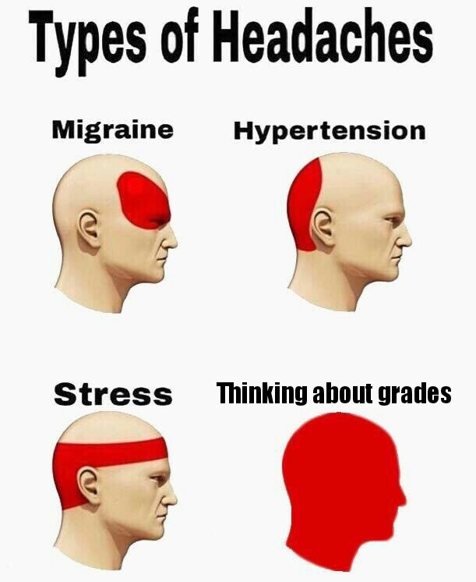
Grading Policy:
Grading Policy:
Not all assignments will be scored. Some assignments are only for practicing, taking risks, and making mistakes.
For all scored assignments, you will receive a grade based on how well you have mastered the concepts and skills.
Grading Scale (Everything is worth 5 points):
You didn’t show much effort or didn’t follow the directions carefully.
You showed some effort, but you still need more practice with these skills.
You showed some good effort and showed that you basically understand the skill.
You showed good effort and have demonstrated that you understand the skills very well.
You went above and beyond. You are a master of these skills.
0. Work incomplete or not turned in.
We will talk more about the specifics of grades as the year goes on, but for now, you should know...

Slide 11
Late Work

Slide 12
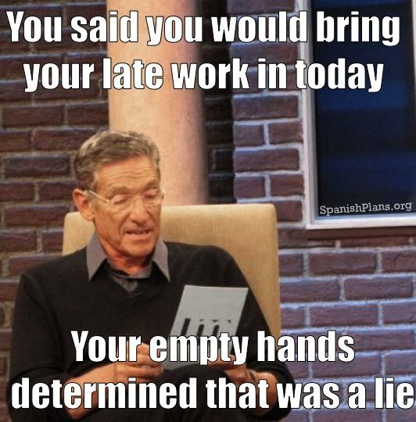
Late Work Policy:
Most work should be completed during class, though you may be asked to read, revise, and edit for homework.
If you don’t think you will be able to complete an assignment on time and you want a 24 hour extension, email me at Luke.MacLennan@sausdlearns.net BEFORE the assignment is due.
If you do not turn in late work within 3 days of the due date, I will start to communicate with your parents, counselor, other teachers, etc. so we can help you get your work finished.
This year is different from other school years, so I am trying to be flexible with late work while encouraging you to be punctual.

Slide 13
Classroom Expectations
Be prepared to learn.
Respect the learning environment.
Give your best effort.
This year I have three expectations for our class:

Slide 14
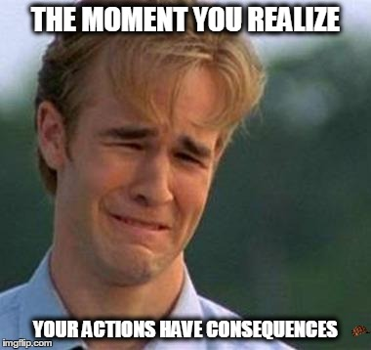
Consequences:
1st time: Warning/Hot Seat
We will have a conversation about what happened and how we can be sure that the problem doesn’t happen again.
2nd time: Communication and Documentation
If it seems like the problem is happening again and again or that this is becoming a habit, I will start to communicate with your parents, other teachers, counselors, and principal and together we will figure out how to help you follow the expectations.
If you are struggling to follow our class expectations, here’s what will happen.

Slide 16
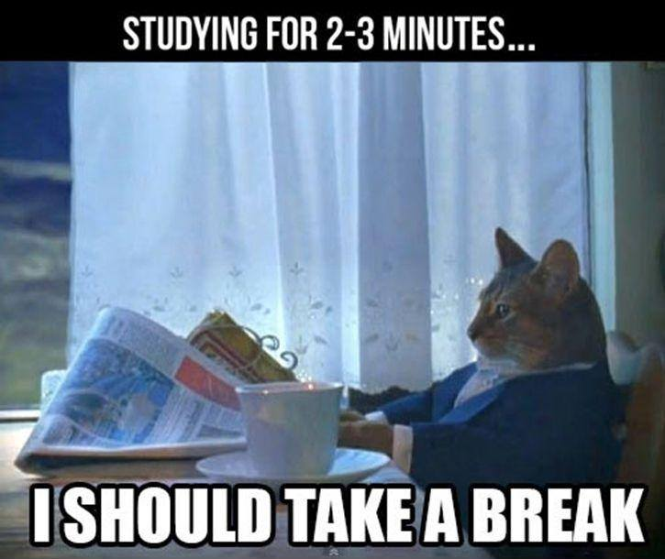
Let’s take a 5-minute break!

Slide 17
Now tell me something about yourself

Slide 18
Personal Information Assignment.
Answer the questions as honestly as possible.
It is due by the end of the day.

